Slide 1
Swasthya Mitra
Smart Healthcare & Management System
UI/UX Design & Prototyping using Figma — A smart doctor appointment and healthcare management platform designed for simplicity, security, and faster access to care.
Created by: Prithwijit Khan, Ayan Koley
Roll Nos: 18842725073, 18842725097
College: Techno College Hooghly
Department: Bachelor of Computer Application

Slide 2
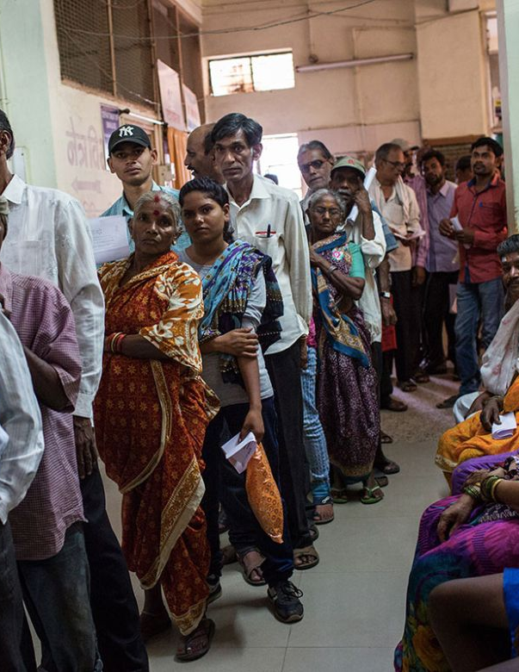
Problem Statement
Patients face friction when accessing care: long in-hospital waits, difficulty finding specialists, manual appointment booking, fragmented medical records, and weak patient–doctor communication. These barriers reduce satisfaction and delay treatment.
Project Objectives:
Reduce wait time
Centralize records
Improve communication
Make booking effortless
Primary Goals
Target Users
Reduce wait time • Centralize records • Improve communication • Make booking effortless
Patients, general practitioners, specialists, clinic admins

Slide 3



Key Features
Patient Features
Website Features
Security
User Registration
Secure Login
Search Doctors
View Doctor Profiles
Book Appointments
Patient Dashboard
Appointment History
Responsive Homepage
About Us Page
Doctor Listings
Developer Information
User Authentication
Protected Patient Data

Slide 4
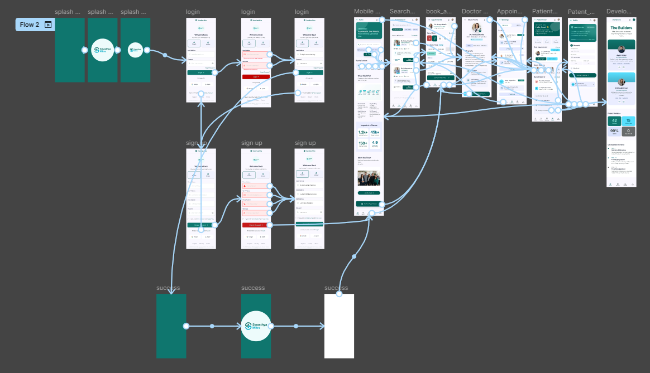
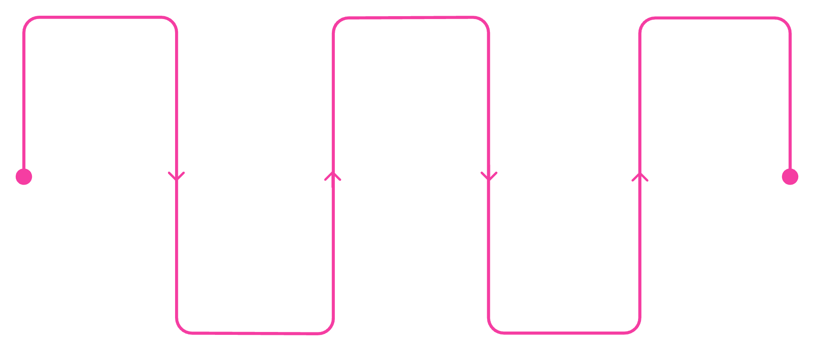
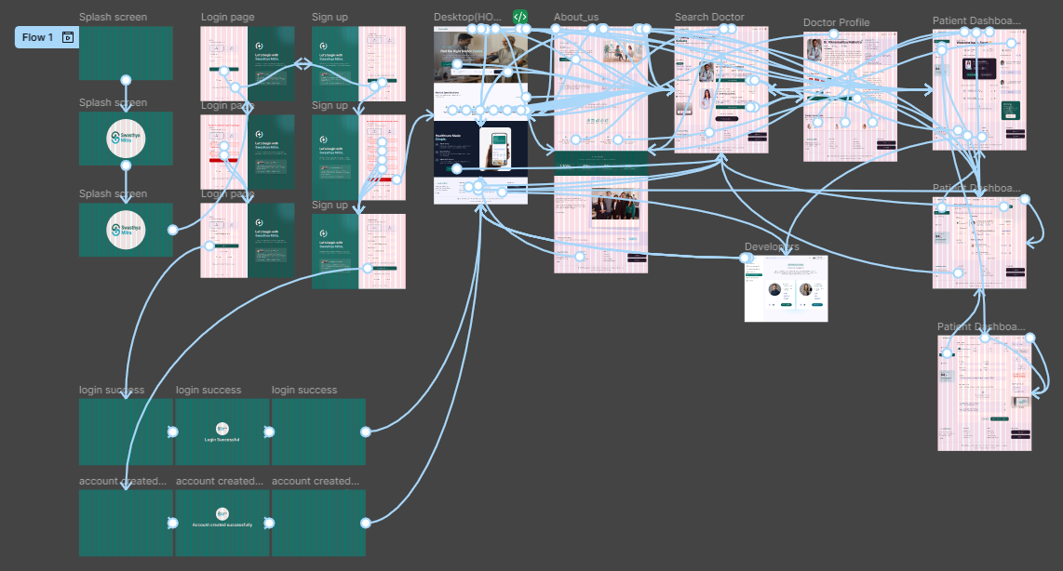
Mobile
User Flow Overview
Start
Home
Book
Splash Screen
Home Page
Appointment & Confirm
Desktop
Auth
Search
Login or Sign Up
Find a Doctor
This streamlined flow minimizes taps between discovery and booking, with checkpoints for authentication, doctor details, and confirmation to reduce errors and no-shows.

Slide 5
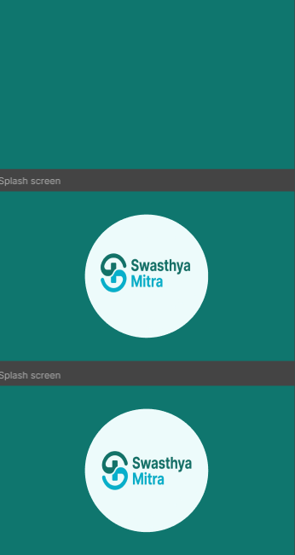
UI Storyboard – Splash Screen
The Splash Screen is the first screen displayed when the application starts.
Purpose:
Displays the application logo
Builds brand identity
Initializes application resources
Redirects users to Login Screen

Slide 6
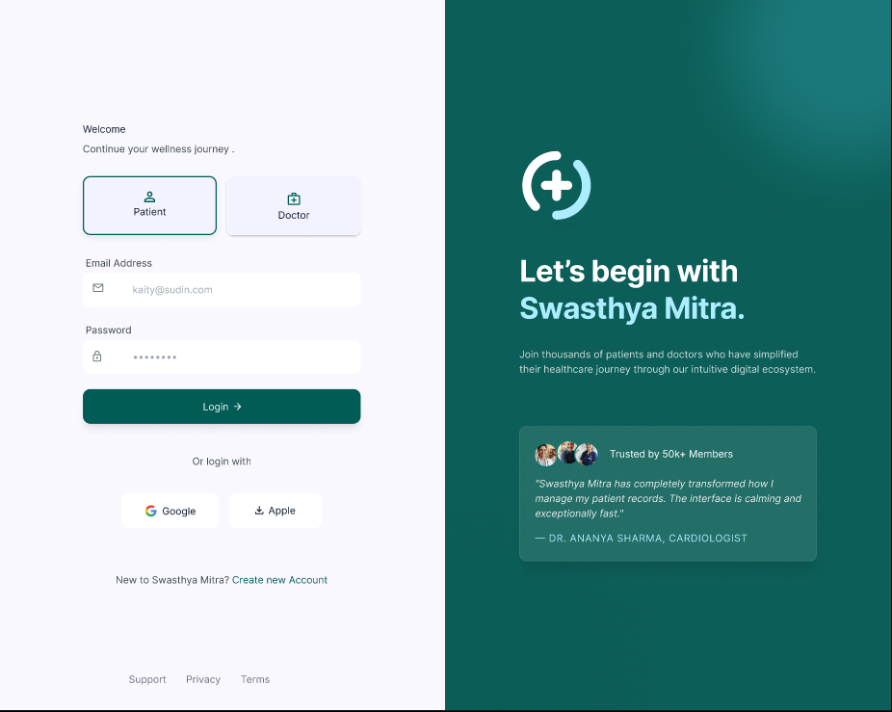
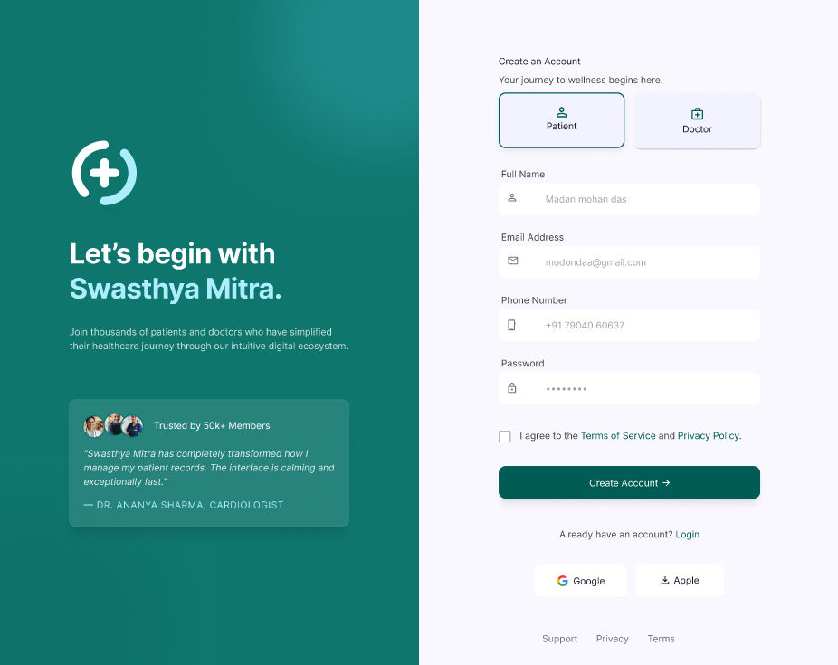
Login & Sign Up
Secure, minimal authentication flows reduce friction while protecting patient data.
01
Login
Email, password, validation, forgot password flow, and 2FA option for sensitive actions.
02
Sign Up
Collect name, email, phone, password, and basic medical profile. Progressive disclosure keeps the form short.

Slide 7
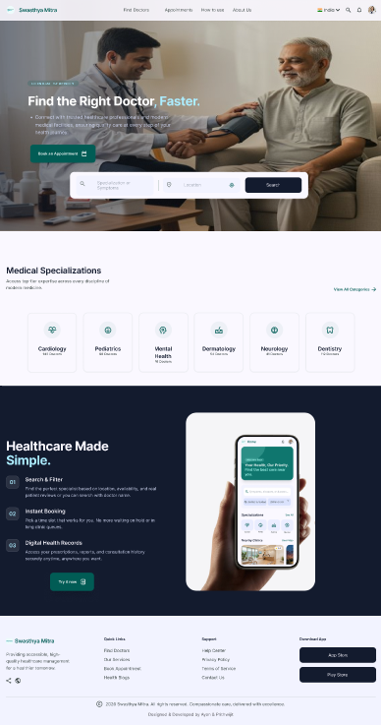
Home Page — Design Highlights
Prominent Search Bar to find doctors by name, specialty, or location
Featured Doctors & Services cards with CTAs to book or view profile
Quick access to Patient Dashboard, Appointment History, and Support
Responsive layout ensures consistent experience across devices

Slide 8
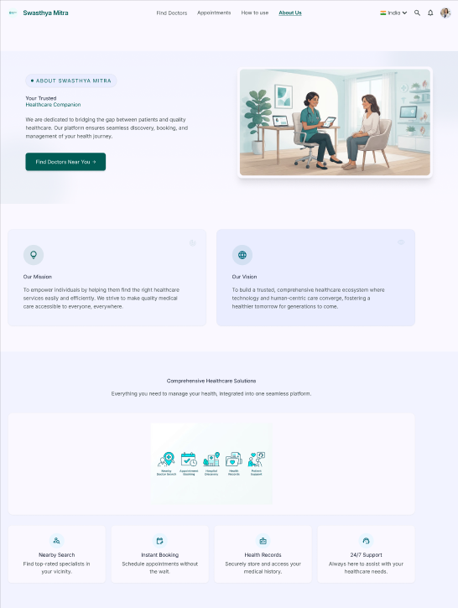

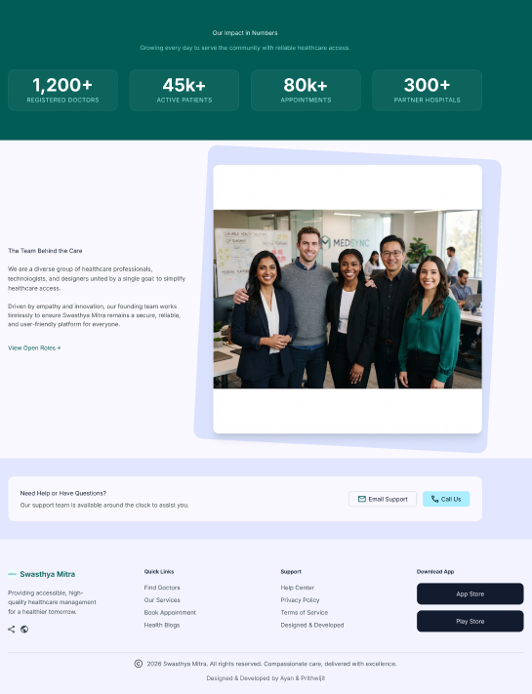

UI Storyboard – About Us
The About Us page provides information about the organization.
Mission
Vision
To empower individuals with effortless access to quality healthcare, fostering a healthier community through technology and compassionate service.
To be the leading digital health platform, recognized for innovation, reliability, and enhancing patient-provider connections globally.
Healthcare Goals
Team Information
Reduce wait times, centralize medical records, improve communication, and simplify appointment booking for all users.
Highlighting the dedicated team of developers, designers, and healthcare experts driving the platform's success.
Purpose:
Build trust with users

Slide 9
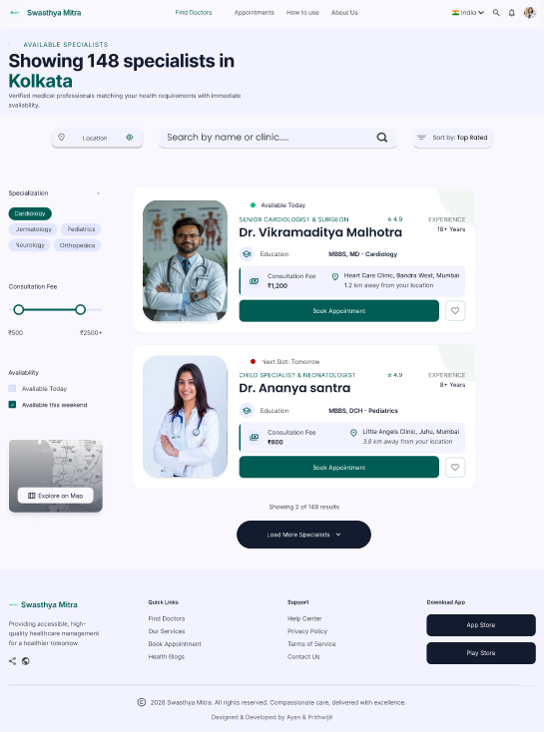
UI Storyboard – Search Doctor
Allows patients to search doctors based on their needs.
Features:
Doctor List
Search Bar
Filter Options
Specialization
Availability
Purpose:
Makes finding the right doctor simple and fast

Slide 10
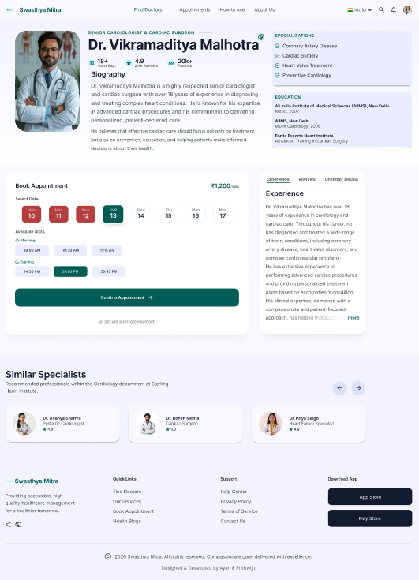
UI Storyboard – Doctor Profile
Displays detailed information about a selected doctor.
Information Includes:
Doctor Photo
Qualification
Experience
Specialization
Ratings
Availability
Book Appointment Button
Purpose:
Helps patients make informed decisions

Slide 11
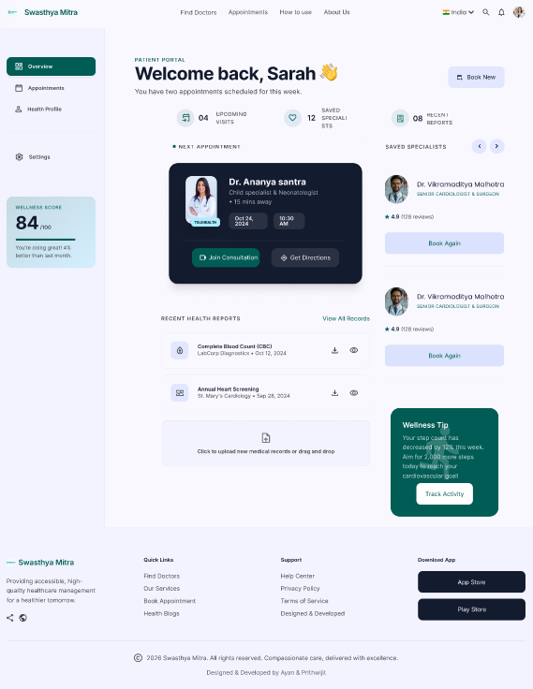
UI Storyboard – Patient Dashboard (Overview)
Welcome panel with quick actions: Book, Cancel, Reschedule
Upcoming & past appointments with doctor details and status
Centralized medical records: reports, prescriptions, and visit history
Notifications and secure messaging with providers

Slide 12
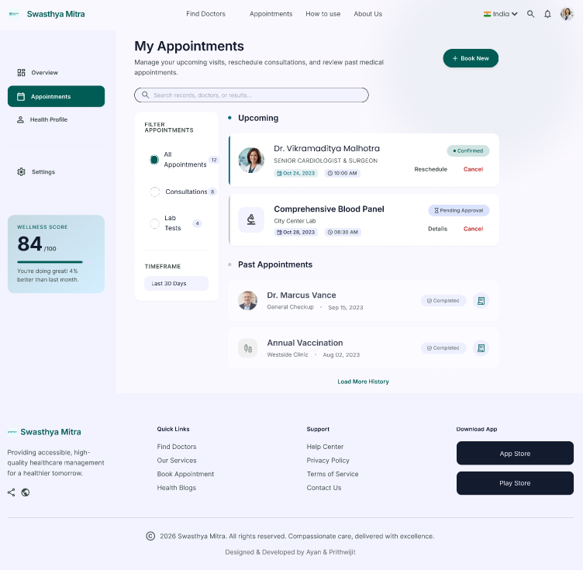
UI Storyboard – Patient Dashboard (Appointments)
Displays appointment information.
Features:
Upcoming Appointments
Previous Appointments
Appointment Status
Doctor Details
Purpose:
Helps patients manage their appointments efficiently

Slide 13
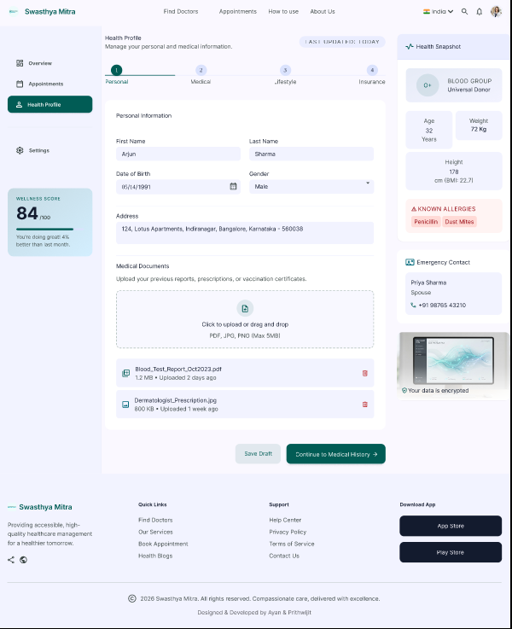
UI Storyboard – Patient Dashboard (Medical Records/Details)
Provides detailed healthcare information.
Features:
Medical Records
Reports
Appointment History
Health Information
Purpose:
Maintains organized digital healthcare records

Slide 14
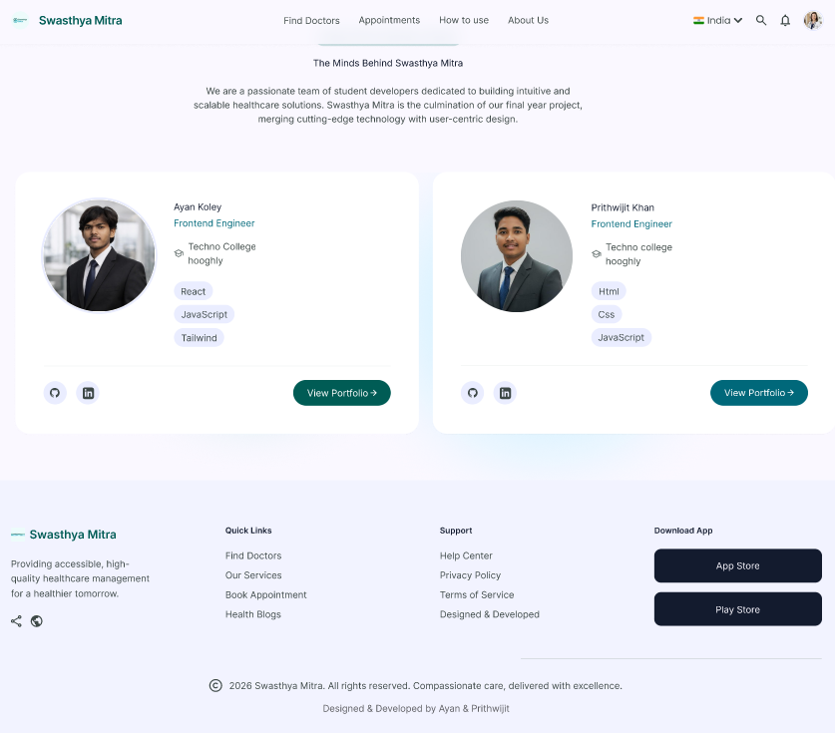
UI Storyboard – Developers
Displays information about the project development team.
Includes:
Team Members
Roles
Contact Information
Prithwijit Khan
Ayan Koley
UI/UX Design & Prototyping
Roll No: 18842725073
Techno College Hooghly, BCA
UI/UX Design & Prototyping
Roll No: 18842725097
Techno College Hooghly, BCA
Purpose:
Acknowledges the contributors to the project

Slide 15
Conclusion & Credits
Swasthya Mitra simplifies healthcare access through a secure, intuitive appointment and records platform—reducing friction for patients and improving operational efficiency for providers.
Team
Next Steps
Prithwijit Khan, Ayan Koley
Techno College Hooghly • BCA
Prototype testing, user feedback sessions, iterate UI, and plan a pilot deployment with partner clinics.
THANK YOU
ayankoley306@gmail.com thisisprithwijit@gmail.com

